Slide 1


Data Structure and Algorithm
LIBRARY MANAGEMENT SYSTEM
Lecturer
?
Member
?

Slide 2
Members' Contribution
Full name | Task

Slide 3

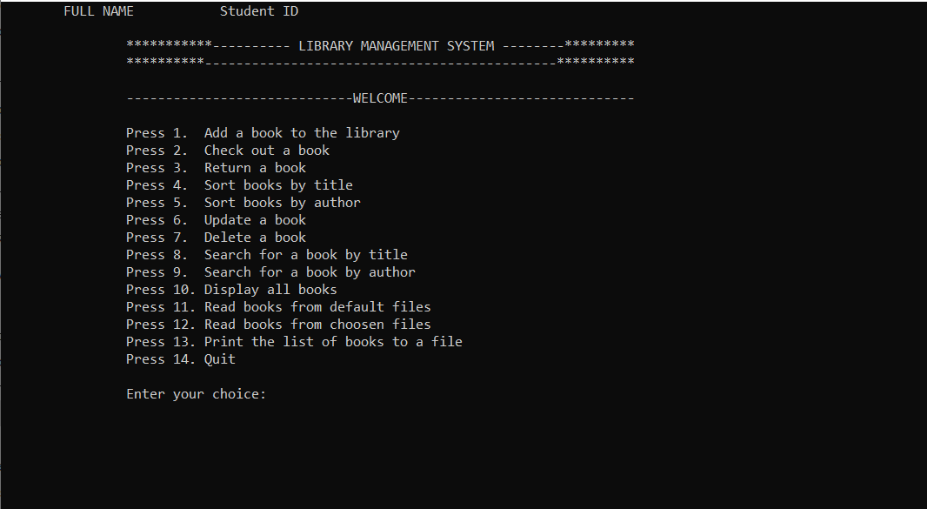
I. Problem
With a large number of books, it's hard to manage them mannually.
The need for Library Management System

Slide 4
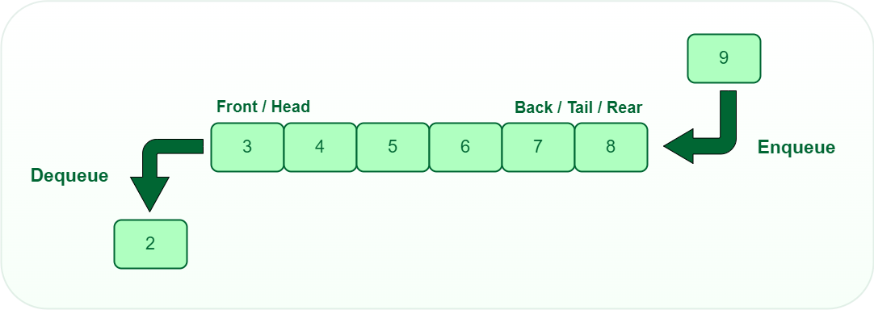
II. Features
Queue in C++
Queues are a type of container adaptors that operate in a first in first out (FIFO) type of arrangement. Elements are inserted at the back (end) and are deleted from the front. Queues use an encapsulated object of deque or list (sequential container class) as its underlying container, providing a specific set of member functions to access its elements.

Slide 5
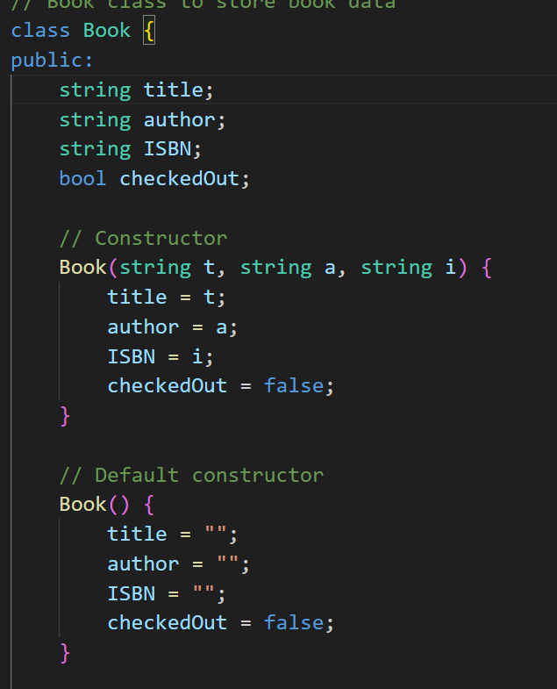
II. Features
Class Book
This code defines a class called Book, which represents a book with a title, an author, and an ISBN number. The Book class has a constructor that allows you to create a new Book object and initialize its title, author, and ISBN. It also has default constructor that initializes the title, author, ISBN, and checkedOut field to empty string and false, respectively.
The Book class has several set and get functions that allow you to get or set the value of the title, author, and ISBN fields. The checkedOut field is a boolean that indicates whether the book is checked out or not.

Slide 6
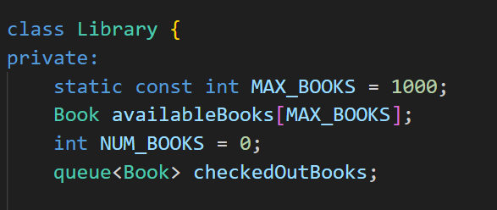
II. Features
Class Library
This code defines a class called Library, which represents a library that stores a collection of Book objects. The Library class has several member variables:

Slide 7
II. Features
Class Library
MAX_BOOKS: a constant integer that represents the maximum number of books that the library can store.
availableBooks: an array of Book objects that represents the books that are currently available in the library (i.e., not checked out).
NUM_BOOKS: an integer that represents the number of books currently in the library.
checkedOutBooks: a queue of Book objects that represents the books that are currently checked out from the library.The Library class has several member functions:
A default constructor that initializes the NUM_BOOKS variable to 0, and empties the checkedOutBooks queue. It also initializes all elements of the availableBooks array to default Book objects.

Slide 8
II. Features
Class Library
addBook: a function that adds a book to the library. It checks if the library is full (i.e., the number of books is equal to MAX_BOOKS), and if it is not, it adds the book to the availableBooks array and increments the NUM_BOOKS variable.
checkOutBook: a function that checks out a book from the library. It searches the availableBooks array for a book with a matching ISBN number, and if it finds one, it sets the checkedOut field of that book to true and adds it to the checkedOutBooks queue. If it doesn't find a matching book, it prints an error message.
returnBook: a function that returns a book to the library. It searches the checkedOutBooks queue for a book with a matching ISBN number, and if it finds one, it sets the checkedOut field of that book to false and adds it back to the availableBooks array. If it doesn't find a matching book, it prints an error message.

Slide 9
II. Features
Class Library
sortByTitle: a function that sorts the available books in the library by title using a bubble sort algorithm.
sortByAuthor: a function that sorts the available books in the library by author using a selection sort algorithm.
updateBook: a function that updates the title and author of a book in the library. It searches the availableBooks array for a book with a matching ISBN number, and if it finds one, it updates the title and author of that book. If it doesn't find a matching book, it prints an error message.

Slide 10
II. Features
Class Library
deleteBook: a function that deletes a book from the library. It searches the availableBooks array for a book with a matching ISBN number, and if it finds one, it removes it from the array by shifting all the books after it to the left. If it doesn't find a matching book, it prints an error message.
displayAllBooks: a function that displays all the books in the library, including both available and checked out books. It first prints a list of all the available books, and then a list of all the checked out books.
readFromFile: a function that reads data from a file and populates the library with books. It opens the specified file, reads in the title, author, and ISBN of each book, and adds them to a queue of books. After all the books have been read, it adds them to the library one by one using the addBook function.

Slide 11
II. Features
Class Library
printToFile: a function that writes the data of all the checked out books to a file. It opens the specified file and writes the title, author, and ISBN of each checked out book to the file, separated by spaces.
searchByTitle: a function that searches for a book with a given title. It searches the availableBooks array and the checkedOutBooks queue for a book with a matching title, and if it finds one, it prints the title, author, and ISBN of that book. If it doesn't find a matching book, it prints an error message.
searchByAuthor: a function that searches for books by a given author. It searches the availableBooks array and the checkedOutBooks queue for books with a matching author, and if it finds any, it prints the title, author, and ISBN of those books. If it doesn't find any matching books, it prints an error message.

Slide 12
II. Features
int main()
This function is a library management system implemented in C++. It allows you to add books to the library, check out books, return books, sort books by title and author, update book information, delete books, search for books by title and author, display all books, read books from a file, and write books to a file. It also maintains a queue of checked out books.

Slide 13
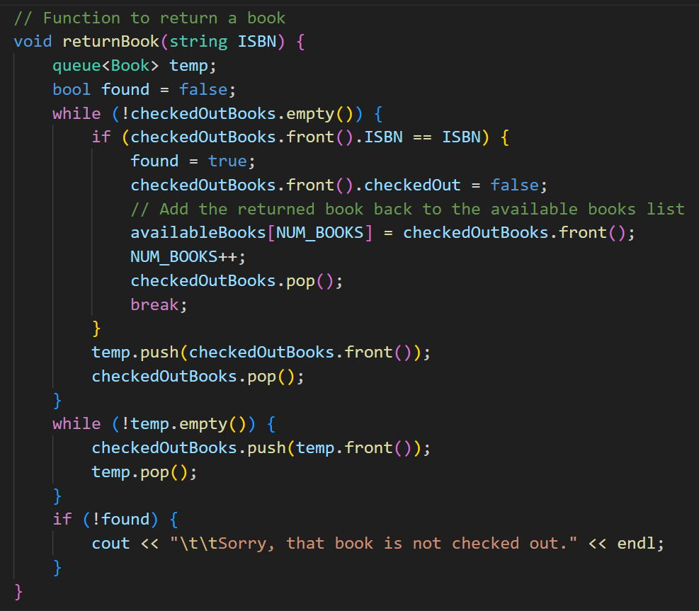
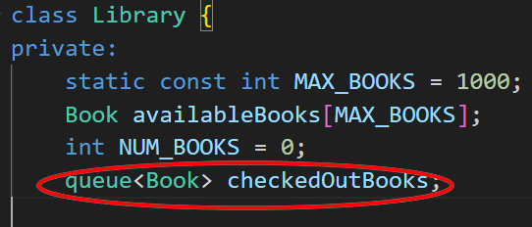
II. Features
Return the book

Slide 14
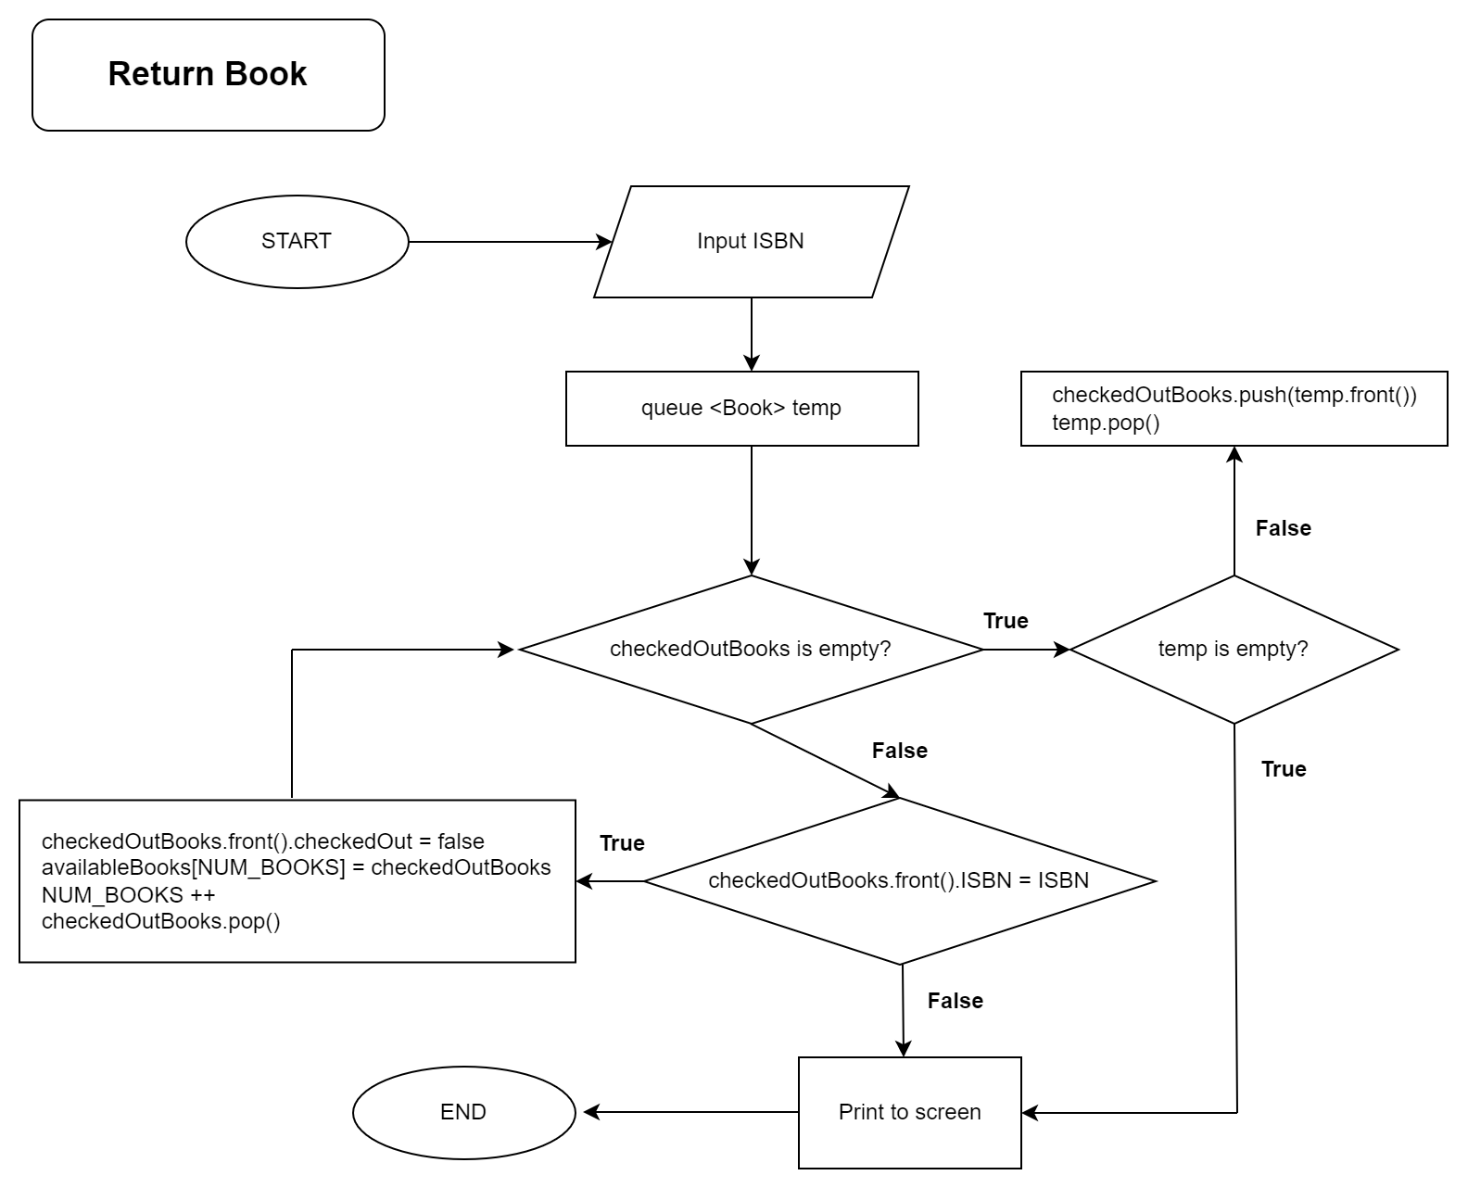
II. Features

Slide 15
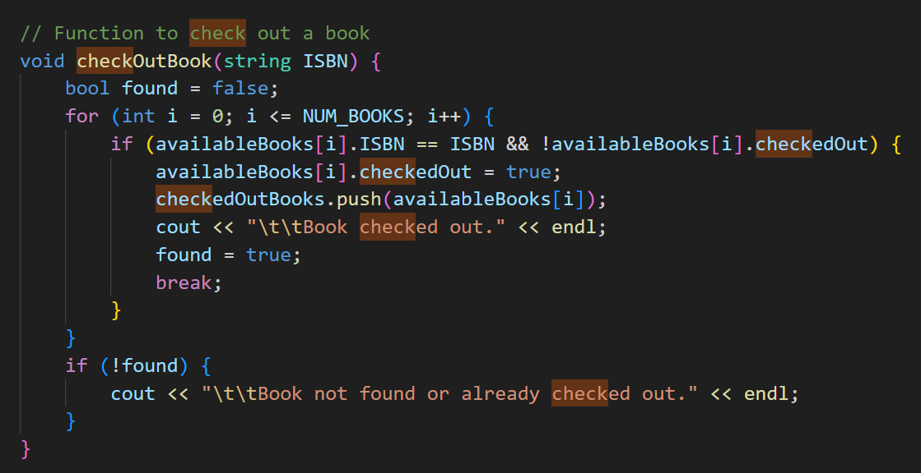
II. Features
Check out the book

Slide 16
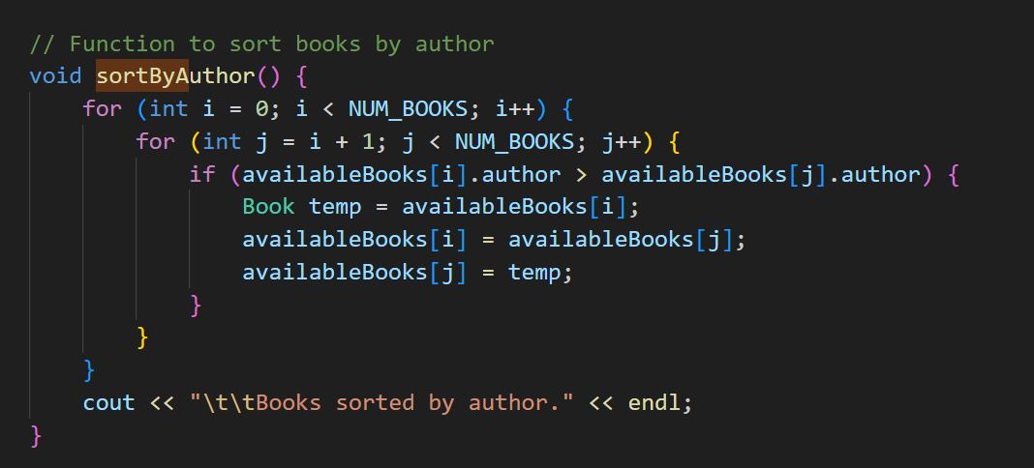
II. Features
Bubble Sort

Slide 17
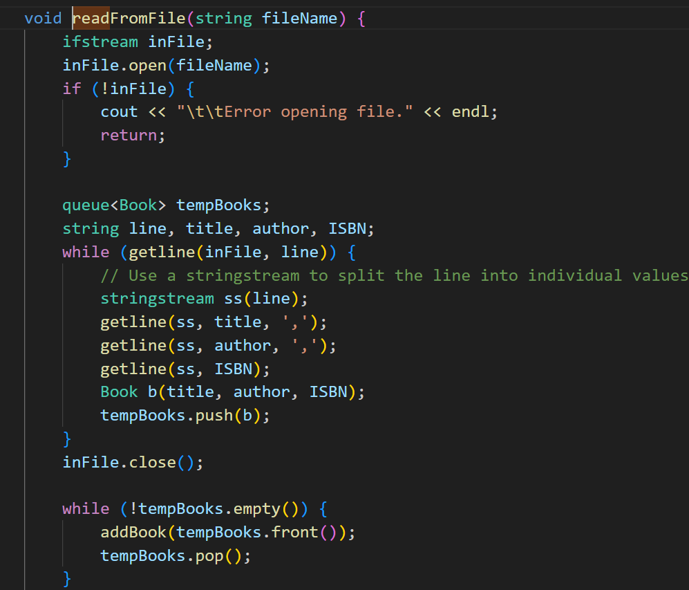
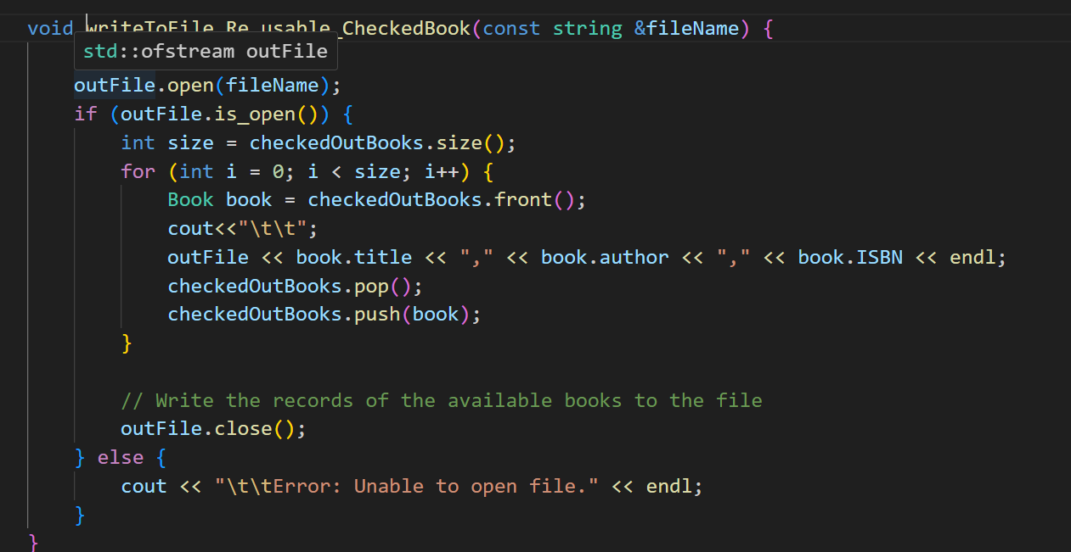
II. Features
Read or Write to a wished Text File

Slide 18
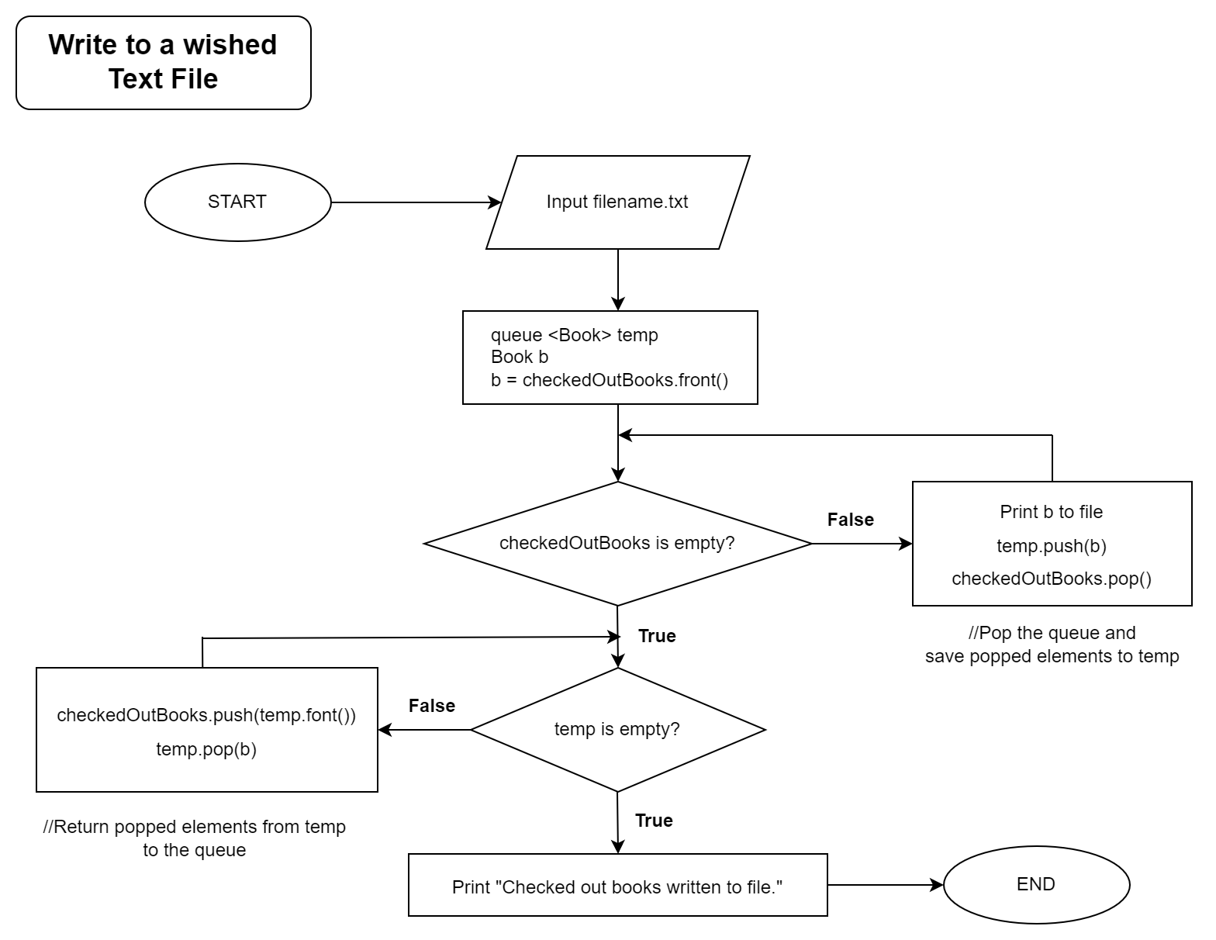

Slide 19
THANK YOU
FOR LISTENING

